Slide 1

JavaScript Fundamentals
Course Introduction
SoftUni Team
Technical Trainers
Software University
https://softuni.bg/

Slide 2
Table of Contents
Course Objectives
Training and Team
Course Organization
Course Infrastructure
Evaluation Criteria

Slide 3
Have a Question?
sli.do
#fund-js

Slide 4











SoftUni Diamond Partners

Slide 5



Educational Partners

Slide 6

Course Objectives

Slide 7
Programming Fundamentals Objectives
Working with linear data structures
Arrays
Defining functions and simple classes
Working with objects
Processing and manipulating strings
Regular expressions

Slide 8
Practical Programming Exam
Mid Exam
3 practical problems for 4 hours
Conditional Statements and Loops
Linear Data Structures – Arrays
Final Exam
3 practical problems for 4 hours
Associative Arrays
Strings and Text Processing
Regular Expressions

Slide 9
Theoretical Exam
You will have 30 minutes once you enter
Multiple choice with 1 or more correct answers
English
Automated quiz system
Available online – open when the practical exam starts and active 30 minutes after it's end
You can submit your answers just one time

Slide 10

The Team

Slide 11
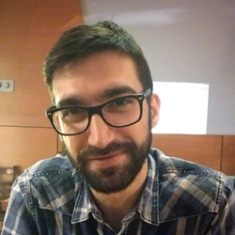
Viktor Kostadinov
Nearly 5 years experience as a technical trainer in the IT field
Head of the R&D Unit at Software University
Former Director of the Education Department
JavaScript enthusiast

Slide 12
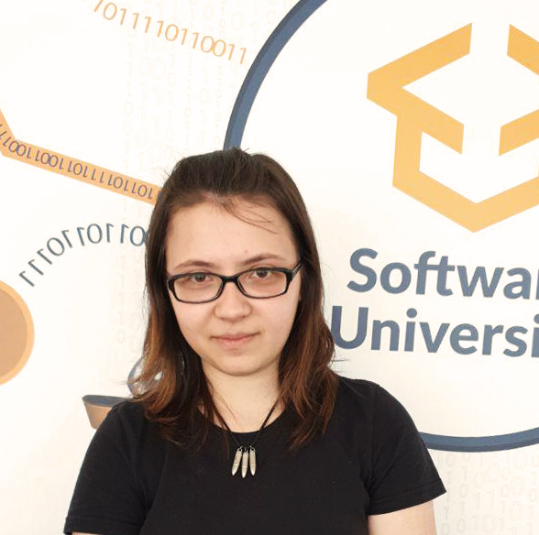
Tanya Staneva
Graduated SoftUni student (JavaScript Developer)
Technical Trainer and Former Team Lead at SoftUni
Currently working as Software Developer (React, Node, Express, Mongo)
Interested in Machine Learning and AI

Slide 13

Course Organization

Slide 14
JS Fundamentals Module
17-May-2021
11-Aug-2021
20-Aug-2021
JS Fundamentals
12 weeks * 3 times / week
12 credits
Start: 17-May-2021
Mid Exam: 3-Jul-2021
Final exam: 14-Aug-2021
Re-Take Exams
Mid Exam Retake: 17-Aug-2021
Final Exam Retake : 20-Aug-2021

Slide 15

Homework Assignments & Exercises
Your homework is mainly work in class
Lesson days → slides + live demos + exercises
Exercise days → only exercises
How to submit your homework?
Submitted in the judge system
Do your homework when it's due
Assignments pile up quickly

Slide 16


SoftUni Certificate
Practical Exam (Final + Mid) 100%
Homework 5 %
Evaluation

Slide 17
CPE Certificate
Theoretical Exam 100%
Evaluation

Slide 18




Course Web Site, Forum
Official web site:
Official discussion forum:
Official JavaScript Facebook group:
Official SoftUni JavaScript Community:
https://softuni.bg/js-fundamentals-may-2021
https://softuni.bg/forum/programming-fundamentals
https://www.facebook.com/groups/JSFundamentalsMay2021
https://facebook.com/groups/SoftUniJavaScriptCommunity

Slide 19
Questions?
Notes:
19

Slide 20
Trainings @ Software University (SoftUni)
Software University – High-Quality Education, Profession and Job for Software Developers
softuni.bg
Software University Foundation
softuni.foundation
Software University @ Facebook
facebook.com/SoftwareUniversity
Software University Forums
forum.softuni.bg
Notes:
20

Slide 21

License
This course (slides, examples, demos, exercises, homework, documents, videos and other assets) is copyrighted content
Unauthorized copy, reproduction or use is illegal
© SoftUni – https://softuni.org
© Software University – https://softuni.bg
Notes:
21

